Slide 1
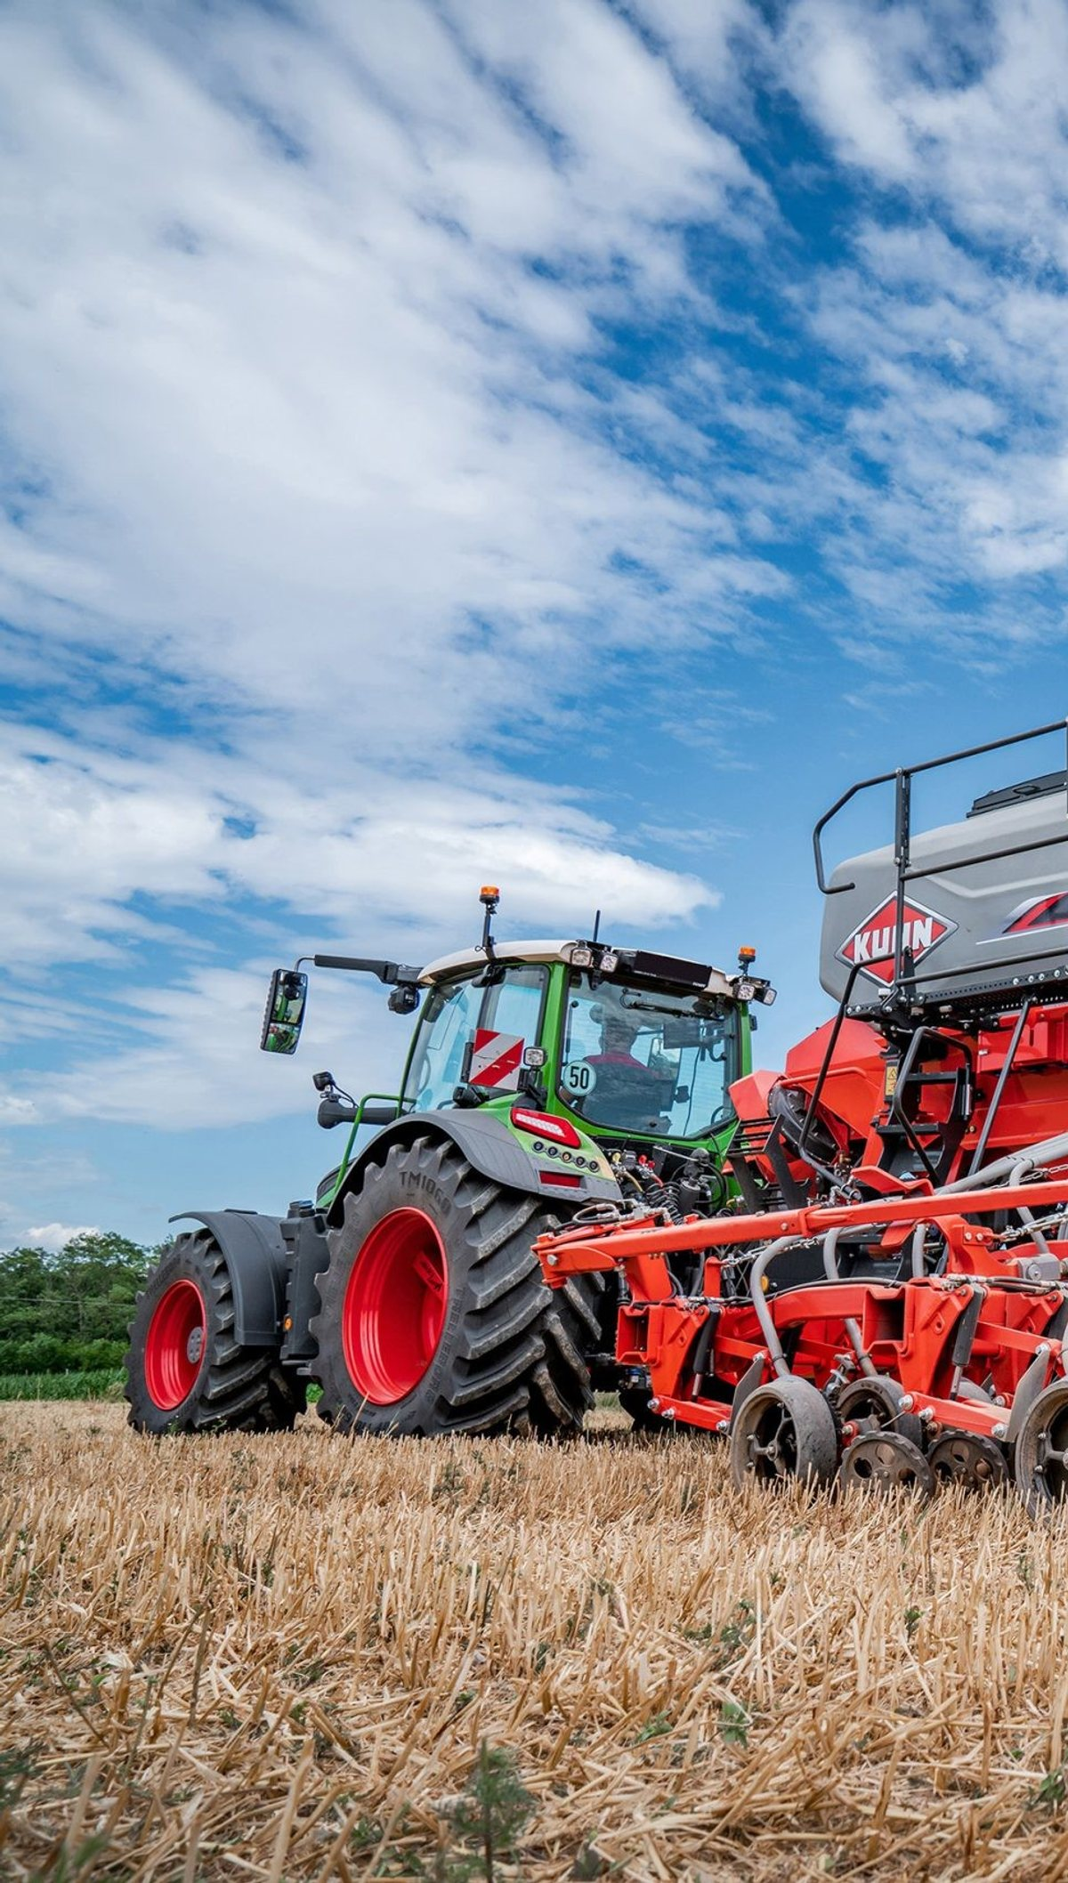

ADVERTISER PACK
2026 / 27
Reach the people
who buy.
For the people who own, run, finance and advise UK farms and rural businesses.
SMARTFARMINGNEWS.COM
COGENT MULTIMEDIA LTD

Slide 2
WHO YOU REACH
The people you’re getting in front of.
THE LIST TODAY
22,003
named farming professionals subscribed to the newsletter.
Smart Farming News goes to farm owners, tenant farmers and estate managers, and the land agents, accountants and lenders who advise them.
41,178
average monthly visits to the Smart Farming News website.
WHAT THEY BUY
Farm machinery and precision technology
60.7%
average open rate against an industry average of 25%.
Farm software, data and drones
Renewable energy and diversification
Agri-finance, lending and tax advice
Insurance and land agency
Feed, seed and livestock technology
4.99%
average click rate against an industry average of 2%.
SMART FARMING NEWS · WHO YOU REACH
2 / 7
Notes:
Subscribers: Mailchimp, subscribed members on 20 Oct 2026. Open and click rates: pooled across all 7 issues sent to this list. Visits: GA4 sessions, 2026-09-20 to 2026-10-19.

Slide 3
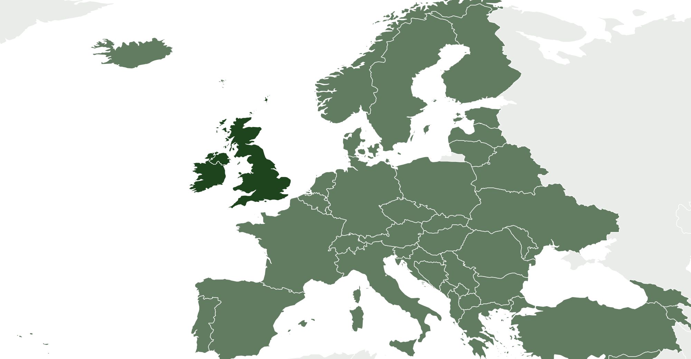
WHO READS · PROJECTED AT SCALE
Who reads Smart Farming News
84% own, direct or manage a farm business. Projected profile at scale, for planning. Measured figures replace these as the list is profiled.
48%
10%
26%
16%
WHERE THEY ARE
Farmer, owner or partner
Director
Farm manager
Farm staff and specialists
MOST COMMON ROLES
Farm owner or partner
40%
Farm manager
22%
Tenant farmer
10%
Estate manager
8.0%
Land agent or adviser
8.0%
Agronomist
5.0%
92%
4.0%
4.0%
UK and Ireland
Europe
Rest of world
FARM TYPE
FARM SIZE
TURNOVER
Arable
30%
Under 100 ha
34%
Under £250k
38%
Livestock
28%
100 to 500 ha
42%
£250k to £1m
36%
Mixed
26%
500 to 1,000 ha
14%
£1m to £5m
20%
Dairy
16%
Over 1,000 ha
10%
Over £5m
6.0%
SMART FARMING NEWS · WHO READS
3 / 7

Slide 4
WHAT YOU CAN BUY
Four ways in.
Every format is digital. Our subscribers have requested to receive content from brands who are able to help their business.
Website banners
Sponsored newsletter content
970×250
300×250
Your brand across the whole site.
Sponsored
Your story in our Monday Briefing, next to our editorial and labelled as sponsored.
HOW A BOOKING RUNS
728×90
01
You tell us what channels you want to use.
970×250 · 728×90 · 300×250
400 words · logo · one link
02
We confirm format, date and price in writing.
03
You send artwork, or copy and we build it.
Newsletter sponsorship
Solus email
04
You approve it before anything goes out.
Sponsor
05
We send the report on your campaign alone.
Your brand as the named sponsor of every issue of our Monday Briefing.
Your email
Your own email, sent to our subscribers. Nobody else in it.
Banner
Per issue, or sponsor a series
We build it, or send finished HTML
SMART FARMING NEWS · WHAT YOU CAN BUY
4 / 7

Slide 5
RATES
Build a campaign.
FORMAT
ONE
THREE
SIX
EMAIL
Our team of marketing experts can work with you to build bespoke campaigns to fit your advertising goals and strategies.
All marketing options are built to send our audience straight to your website with one easy click.
Whatever you chose, it’s designed to deliver traffic to you.
Eshot
£1,000
£750
£500
Your message alone, nobody else in it
EACH
EACH
Newsletter sponsorship
£800
£600
£400
Named sponsor of the Monday Briefing
EACH
EACH
CONTENT
Sponsored article
£200
£150
£100
On the website and in the newsletter
EACH
EACH
DISPLAY
ONE MONTH
THREE MONTH
SIX MONTH
Homescreen Pop-Up
£1,200
£2,700
£3,600
Pops up after 6 seconds
TOTAL
TOTAL
Billboard, 970×250
£900
£2,100
£3,000
TALK IT THROUGH
Top of the homepage
TOTAL
TOTAL
jb@smartfarmingnews.com
Leaderboard, 728×90
£600
£1,200
£1,800
Across the site
TOTAL
TOTAL
MPU, 300×250
£400
£800
£1,200
Sidebar button
TOTAL
TOTAL
All rates exclude VAT
SMART FARMING NEWS · RATES
5 / 7

Slide 6
WHAT RESULTS YOU GET
The numbers
you get back.
Statistics
All numbers are an average
EMAIL CAMPAIGN
Delivered
Inboxes it actually reached
22,003
Within 7 days of your campaign finishing, you’ll receive a full performance report showing impressions, open rate and click-throughs to your website.
Unique opens
People who opened, counted once
60.7%
Unique clicks
People who clicked, counted once
5.0%
Click to open
Of those who opened, who then clicked
8.2%
Unsubscribes
Off the list after your send
0.06%
ON THE SITE
Monthly Total Visits
Total impressions on your content
41,178
WHEN YOU GET A REPORT
Monthly Unique Visitors
Unique users who saw your content
28,156
Within 7 working days of the send.
SMART FARMING NEWS · WHAT RESULTS YOU GET
6 / 7
Notes:
Delivered is the current list size. Rates pooled across 7 issues. Visits and unique visitors: GA4 sessions and total users, 2026-09-20 to 2026-10-19.

Slide 7
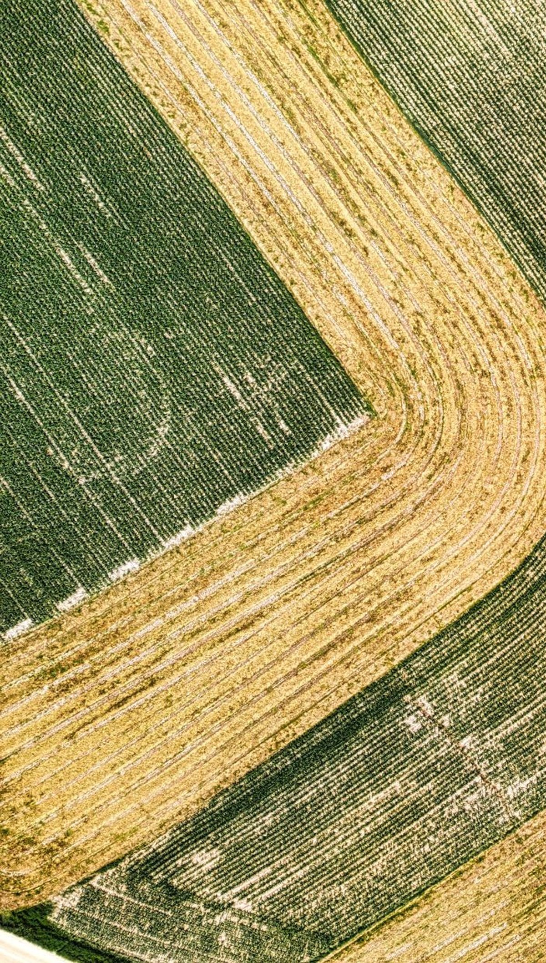
ADVERTISE WITH US
Get in touch.
Tell us who you are trying to reach and what you want it to do, and we will come back with a plan, availability and a price.
ADVERTISING
jb@smartfarmingnews.com
SEND US A STORY
smartfarmingnews.com/submit-news
SUBSCRIBE FREE
smartfarmingnews.com/newsletter
PUBLISHED BY · COGENT MULTIMEDIA LTD, 5 JUBILEE WAY, FAVERSHAM, KENT

